Slide 1



01
02
03
04
4
Doubtful Dan
What Should They Do?
Holly’s Discovery
Hopeful Holly
3
Meet Our
Holly finds the Credit Counselling Society
CUSTOMERS
Option A
Option B
2
They recommend debt consolidation
Holly’s Choice
Dan’s Choice
1
Seeks an alternative to their debt spiral
Continue paying high-interest debt
Current lenders reject Holy
Background:
Conestoga graduate, $ 20,000 in debt, stubborn to seek help
Background:
Laurier graduate, $ 20,000 in debt, willing to seek help
Reaches out to a credit counselling service
Continue this cycle in a spiral

Slide 2
02
01
03
04
4
Doubtful Dan
What Should They Do?
Holly’s Discovery
3
Hopeful Holly
Holly finds the Credit Counselling Society
Meet Our
Option A
Option B
2
CUSTOMERS
They recommend debt consolidation
Holly’s Choice
Dan’s Choice
1
Seeks an alternative to their debt spiral
Continue paying high-interest debt
Current lenders reject Holy
Background:
Conestoga graduate, $ 20,000 in debt, stubborn to seek help
Background:
Laurier graduate, $ 20,000 in debt, willing to seek help
Reaches out to a credit counselling service
Continue this cycle in a spiral

Slide 3
01
03
02
04
4
What Should They Do?
Doubtful Dan
Holly’s Discovery
3
Hopeful Holly
Holly finds the Credit Counselling Society
Meet Our
Option A
Option B
2
CUSTOMERS
They recommend debt consolidation
Holly’s Choice
Dan’s Choice
1
Seeks an alternative to their debt spiral
Continue paying high-interest debt
Current lenders reject Holy
Background:
Conestoga graduate, $ 20,000 in debt, stubborn to seek help
Background:
Laurier graduate, $ 20,000 in debt, willing to seek help
Reaches out to a credit counselling service
Continue this cycle in a spiral

Slide 4
01
02
04
03
4
Doubtful Dan
Holly’s Discovery
What Should They Do?
Hopeful Holly
3
Holly finds the Credit Counselling Society
Option A
Option B
Meet Our
2
CUSTOMERS
They recommend debt consolidation
Holly’s Choice
Dan’s Choice
1
Current lenders reject Holy
Seeks an alternative to their debt spiral
Continue paying high-interest debt
Background:
Conestoga graduate, $ 20,000 in debt, stubborn to seek help
Background:
Laurier graduate, $ 20,000 in debt, willing to seek help
Reaches out to a credit counselling service
Continue this cycle in a spiral

Slide 5
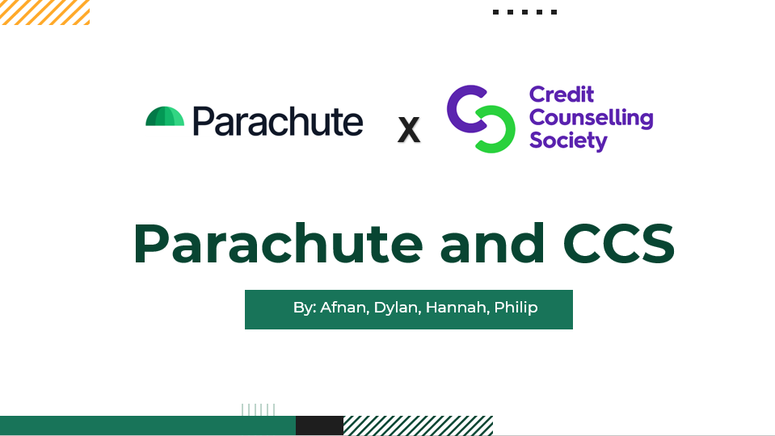
01
02
03
04
4
Doubtful Dan
What Should They Do?
Holly’s Discovery
Hopeful Holly
3
Holly finds the Credit Counselling Society
Meet Our
!!
Option A
Option B
2
CUSTOMERS
They recommend debt consolidation
Holly’s Choice
Dan’s Choice
1
Seeks an alternative to their debt spiral
Continue paying high-interest debt
Current lenders reject Holy
Background:
Conestoga graduate, $ 20,000 in debt, stubborn to seek help
Background:
Laurier graduate, $ 20,000 in debt, willing to seek help
Reaches out to a credit counselling service
Continue this cycle in a spiral

Slide 6
This was our title slide, but it was an image due to transition purposes, obviously I cannot include for that reason since our names are on it.
01
02
03
04
4
Doubtful Dan
What Should They Do?
Holly’s Discovery
Hopeful Holly
3
Holly finds the Credit Counselling Society
Meet Our
Option A
Option B
!!
2
CUSTOMERS
They recommend debt consolidation
Holly’s Choice
Dan’s Choice
1
Seeks an alternative to their debt spiral
Continue paying high-interest debt
Current lenders reject Holy
Background:
Conestoga graduate, $ 20,000 in debt, stubborn to seek help
Background:
Laurier graduate, $ 20,000 in debt, willing to seek help
Reaches out to a credit counselling service
Continue this cycle in a spiral

Slide 7






Introducing CCS
That’s where Parachute comes in.
A mutually beneficial collaboration between CCS and Parachute
A non-profit organization that helps with debt reduction and management
They offer 6 programs to address different circumstances
They have sub-prime and net-prime customers, but no debt-consolidation solution
Parachute provides debt consolidation services to CCS’ sub-prime and net-prime customers
Parachute reaches its target of 5,000 loans in
5 years

Slide 8
Our Recommendation
A mutually beneficial collaboration between CCS and Parachute
Parachute provides debt consolidation services to CCS’ sub-prime and net-prime customers
Parachute reaches its target of 5,000 loans in
5 years

Slide 9

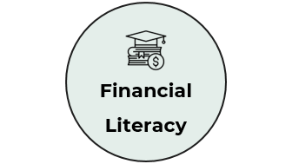




Why is this the best option for parachute?
It addresses our 3 vital decision criterion

Slide 10

Acquisition

Slide 11
Acquisition
We estimate an increase of approximately 1500 customers annually

Slide 12

Financial Literacy

Slide 13
Financial Literacy
Parachute handles debt relief through consolidation and our friends at CCS do the rest

Slide 14

Brand Exposure

Slide 15
IMPLEMENTATION PLAN
CCS x PARACHUTE
Brand Exposure
Immediate
Initial Contact & Meetings with CCS
Reach Terms & Conditions of Deal
0-3 months
Short
Develop New Marketing Plan
Agree upon Target Customers
3-12 months
This collaboration reinforces the idea that Parachute is committed to responsible lending and financial well-being
INSERT
Long
Unveil New Partnership to Consumers
Adjust Strategy upon Consumer Feedback
12+ months

Slide 16
IMPLEMENTATION PLAN
CCS x PARACHUTE
Immediate
Initial Contact & Meetings with CCS
Reach Terms & Conditions of Deal
0-3 months
Short
Develop New Marketing Plan
Agree upon Target Customers
3-12 months
Long
Unveil New Partnership to Consumers
Adjust Strategy upon Consumer Feedback
12+ months

Slide 17
MARKETING PLAN
REVIEWS/TESTIMONIALS
SOCIAL MEDIA
DIRECT MARKETING
EMAIL MARKETING

Slide 18


Slide 19



Risk
Filling the Pockets of Today for the Greater of Tomorrow.
Contingency
Declined Offer
Offer Incentive
Low Customer Acquisition
Customer Feedback
Low Credit Score Client Rejections
Develop a System For Appeals

Slide 20
Filling the Pockets of Today for the Greater of Tomorrow.

Slide 21
Appendix Directory
CCS’s Benefits
Why CCS vs Alternatives
Cons of CCS
Target Audience
Synergy
Security of Partnership
Flexibility of Partnership
Success Indicators
Cost-Benefit Analysis
Long Term Vision
Estimation Calculations
Reputability of CCS
Risks, Mitigations & Contingencies
Gantt Chart
Statistics

Slide 22
How Does the CCS Monetarily Benefit?
Short answer: It doesn’t.
Remember that:
The CCS is a non-profit organization
Has many founders and supporters
However…
All referred loaners through the CCS will reject credit scores like Holly’s or Dan’s
Thus, this partnership aims to leverage Parachute’s differentiated business model to reach a broader audience
This strategy will align with the values of both companies to help the community as much as possible
Instead, we will fulfill the company’s purpose instead of monetarily benefiting it

Slide 23
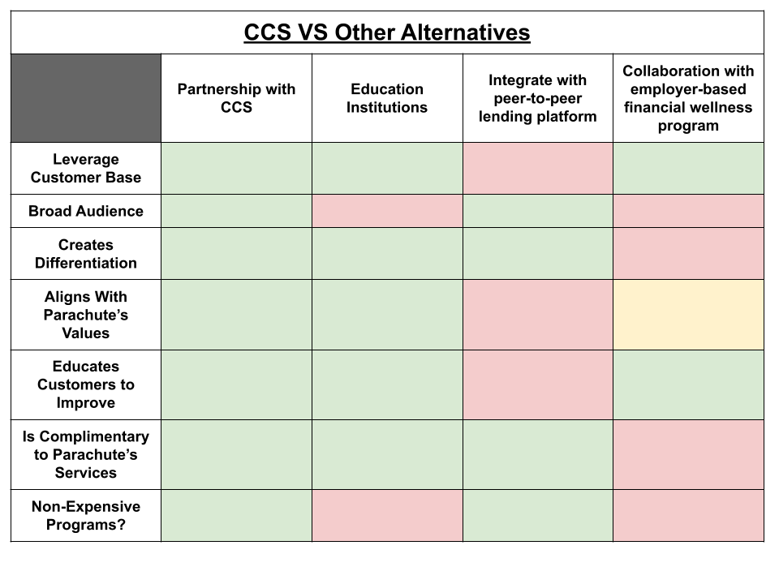
Why the CCS Over Other Alternatives?
While there are many other options, we favour the CCS since:
- Services align best with Parachute’s future initiative to expand programs (i.e. graduate programs)
  Workshops, existing partnerships, geographic presence
- Highly credible company
- Operates on a client-focused approach
- Lacks what parachute can provide

Slide 24
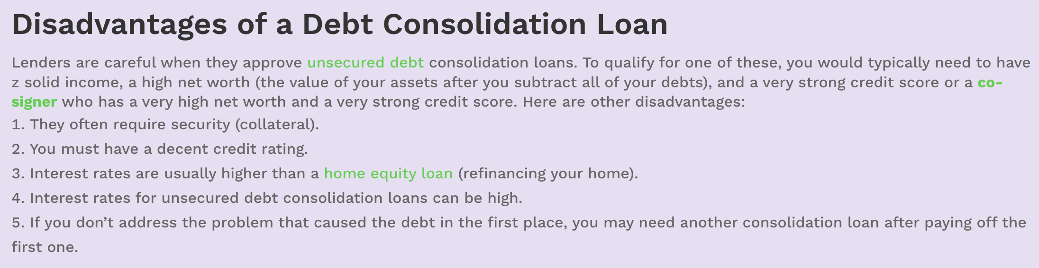
CCS' Disadvantages
The main disadvantage is being able to qualify for a loan

Slide 25
Who is Our Target Audience?
Anyone who is past the threshold of being a student:
Why not Students?
Students already receive ample loan support through OSAP and similar services
Effective as of April 1st, 2023, all student loans have 0% interest in Canada⁴
Many students have not/cannot accumulate a credit score that bad yet
Why would someone want to pay a 30% loan interest if they don’t have to?
Diversifying Consumer Base:
According to the Q&A, Parachute’s average customer age is 42 with an income ~84K
While inclusive, this partnership aims to diversify this audience within the CCS’ consumer base, while also granting Parachute exposure

Slide 26
How Does this Synergy Work?
By enforcing credit counselling as part of the loan application process:
Anyone can apply for debt consolidation, provided their credit scores are not sub-prime or below (except for Parachute)
By streamlining credit counselling as part of this process, borrowers receive more guidance on managing their finances to prevent future debt issues before they arise
Credit counselling with help borrowers at risk of defaulting on loans
Increased chances to improve creditworthiness
Creates a positive community impact by promoting financial literacy and stability
Creates a competitive advantage that sub-prime borrowers can receive similar services, whereas most companies do not serve these borrowers

Slide 27
Security of Partnership?
This partnership enforces data minimization:
Parachute and the CCS do not need to share much information about the customer between each-other, making it the most secure out of all other partnerships
No third-party vendors are involved in handling customer data
Both Parachute and the CCS disclose transparent privacy policies
Companies share the same vision and values:
There will be no confusion towards the business structure of the partnership
Since it is a for-profit x non-profit partnership, there is little room for exploitation (how the company’s benefit from each-other is non-exploitable)

Slide 28
Flexibility and Adaptability of Partnership?
Inside the Company:
Parachute will be able to gradually take in more loans
Governance between two companies will be made solely by the company for their own programs (they mostly refer rather than combine programs)
Outside the Company:
If customer needs switch to net-prime/super-prime market, Parachute will already be there by using CCS as a “crutch” for graduate programs
If economic conditions improve, parachute will struggle regardless of the partnership, however since the CCS is a non-profit, any change in economic conditions will not put financial strain on Parachute as result of the partnership (since CCS has no monetary gain directly from Parachute)
If economic conditions worsen, both services will be more sought after

Slide 29
Success Indicators?
KPIs that will be monitored and its effects:
Past customers become more loyal
Net promotor scores increase with each customer helped
  Shown through customer satisfaction surveys, which provides opportunity to cross-sell/upsell opportunities
Retention rates will be consistent amongst those who have used both company’s services
Loan repayment rates will increase with more financial awareness
Default rates will decrease with more financial awareness
Credit score rates increase with more financial awareness
Customer engagement increases with more financially capable customers

Slide 30
Cost Benefit Analysis?
Costs:
Integration of systems + processes
Advertising joint programs
Legal compliances and expenses
KPI tracking
Benefits:
Increased customer retention
Reduced default rates
Customer satisfaction
Brand loyalty
Community impact
Potential savings (more efficient loan processing)
Improved credit scores
Additional cross-selling opportunities (i.e., incorporating a new workshop/program)
Can only be determined after partnership is established
Total Benefit – Total Costs = Net Benefit
(Net Benefit/Total Costs) * 100 = ROI

Slide 31
Long-Term Vision?
The CCS compliments Parachute’s desire for expansion:
Parachute would like to expand throughout Canadian provinces and additional countries (US and UK)
Parachute would like to implement graduate programs that reach beyond subprime borrowers
The CCS has began building a more national presence, which can be supported through the collaboration with Parachute
By the time Parachute is ready to expand, the CCS will be more developed nationally (potentially internationally), which will help Parachute do the same
Create a new norm:
That customers of all credit scores can receive help in one way or another
Streamline financial awareness and education alongside the loan application process

Slide 32
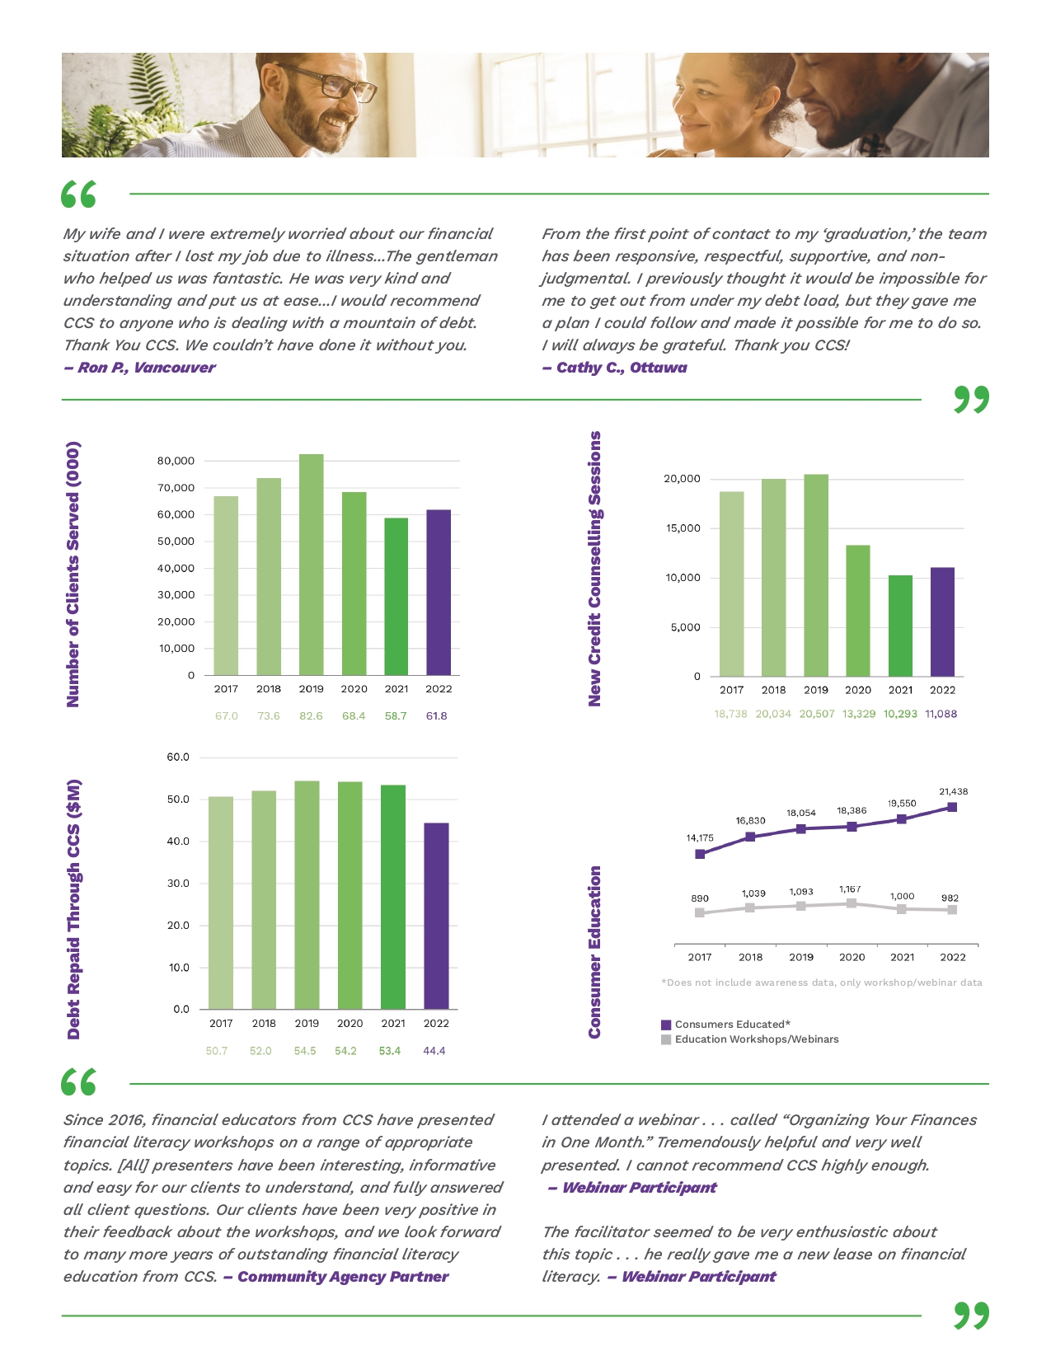
Estimation Calculations

Slide 33
Reputability of CCS
“My wife and I were extremely worried about our financial situation after I lost my job due to illness...The gentleman who helped us was fantastic. He was very kind and understanding and put us at ease...I would recommend CCS to anyone who is dealing with a mountain of debt. Thank You CCS. We couldn’t have done it without you.”¹

Slide 34
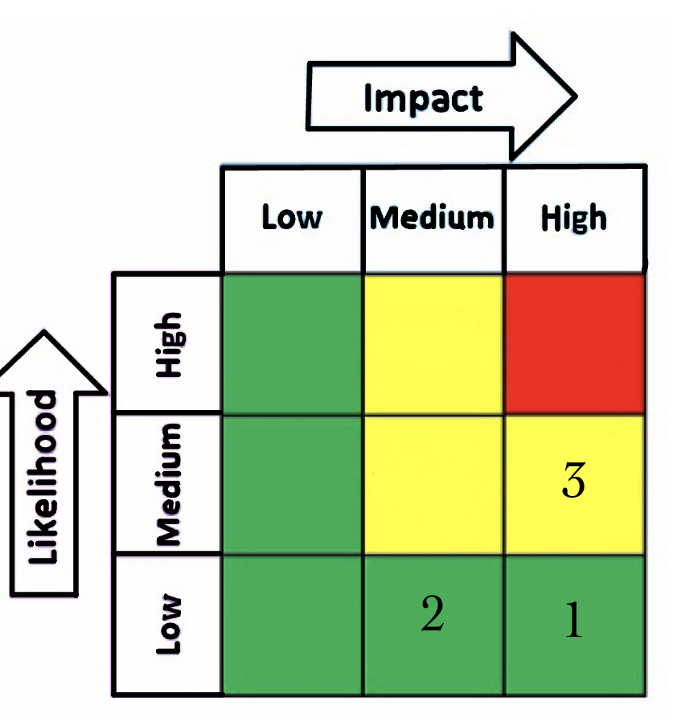
Risks, Contingency and Mitigation
CCS rejects collaboration offer
Contingency: address any worries CCS may have about the partnership.
Mitigation: Before a full-scale implementation, Parachute might also suggest a pilot initiative to test the partnership on a smaller scale. This enables the two companies to evaluate the effects and deal with any unexpected challenges.
2. Low Customer Acquisition Despite Partnership with Credit Counselling Society
Contingency: Review customer feedback, understand their experiences, identify any challenges, and use this information to enhance the customer acquisition process. Also, carry out an in-depth analysis of the performance indicators and client acquisition tactics.
Mitigation: Work together to enhance marketing campaigns with CCS.
3. CCS clients still facing rejection
Contingency: Develop a process for appeals for situations in which a client's credit score is so low that they are rejected. In this procedure, financial conditions other than credit score may be reviewed for each individual.
Mitigation: Collaborate with CCS to create a pre-screening system that identifies customers whose credit scores are probably going to meet Parachute's minimum criteria.

Slide 35
Gantt Chart
STEPS | MONTH | 1 | 2 | 3 | 4 | 8 | 12 | 15 | 18 | 21 | 24
1. Kick-off
2. Business Insights
3. Mission and Vision
4. Develop Marketing Plan
5. Strategy Meetings
6. Review Financials
7. Launch Marketing
8. Review Feedback

Slide 36
Other Statistics
Supporting Statistics:
A study conducted by Visual Objects shows that 71% of consumers express a strong preference for co-branding partnerships. Additionally, 43% of consumers are inclined to try a co-branded product offered from a company they already liked.²
According to a Ipsos survey by MNP LTD in 2018, many Canadians agreed there is a lack of financial literacy within the Canadian population. Less than 15% of Canadians believe they have strong financial literacy skills, while 39% rate their knowledge as poor.³

Slide 37
References
Credit Counselling Society Annual Report. Credit Counselling Society. (2022).
https://nomoredebts.org/about-us/credit-counselling-society/ccs-annual-report
2. 4 essentials for co-branding Success. Visual Objects. (n.d.). https://visualobjects.com/digital- marketing/blog/cobranding
3. Financial Literacy in Canada lack of skills and education contributing to surging consumer debt. MNPDebt.ca. (n.d.). https://mnpdebt.ca/en/resources/mnp-debt-blog/financial-literacy-in- canada-lack-of-skills-and-education-contributing-to-surging-consumer-debt
4. What’s new. (n.d.). https://www.csnpe-nslsc.canada.ca/en/what-is-new

Slide 38
Liscences
All vector icons are made by Pixel perfect from www.flaticon.com
PowerPoint template modified from www.slidesgo.com
Person Icons attributed to www.vecteezy.com

Slide 39


Slide 40
